Slide 1
Fresh Grads – Group Project
Home Insurance Management System

Slide 2
Problem Statement 1
Admin should be able to perform below operations:
Login into the Application
Policy Management
Agent Management
Policy Holder Management

Slide 3
Problem Statement 2
Agent should be able to perform below operations after login:
View Policies
View Policy Holders
View Properties
Provide/View Policy Quotes
Customer should be able to perform below operations after login:
View Policy
View Personal Details
Make Payment

Slide 4
Road Map
Application will be developed in following Sprints –
Core Java +JPA with Hibernate
Spring Boot + Rest Controller + JPA with Hibernate
Angular for UI design (Front End) + Integration with previous Sprint

Slide 5
Plan
Design and Approach
Design
Generate the skeleton as per class design provided
TDD approach
Identify test cases for each module
Write Failing Test cases
Convert the Test Cases in GREEN
Implement the case study in incremental manner

Slide 6
Modules
Login Module
Owner/
Policy Holder Module
Quote Management Module
Property Management
Module
Admin Module
Agent
Module
Policy
Management Module

Slide 7
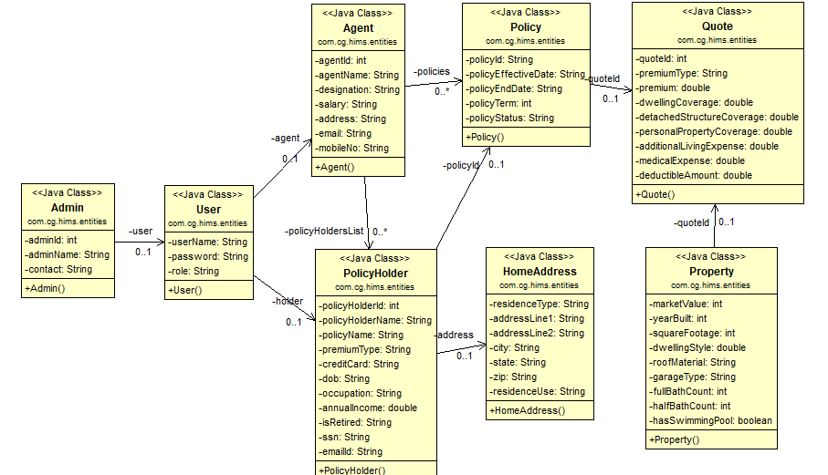
Class Design
POJO Classes:

Slide 8
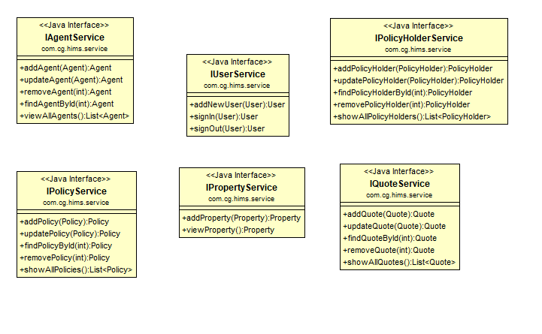
Class Design
Service Interface:

Slide 9
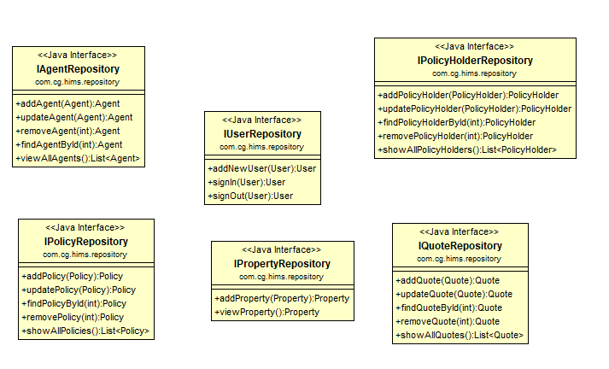
Class Design
Repository:

Slide 10




Questions

